Slide 1
Reinforcement Learning Curriculum
Q-Learning
Deep Q-Learning
Environment Design
Deep Convolutional Q-Learning
Ek-1: Artificial Neural Networks (ANN)
Ek-2: Object Oriented Programming (OOP)
Ek-3: Convolutional Neural Networks (CNN)

Slide 2
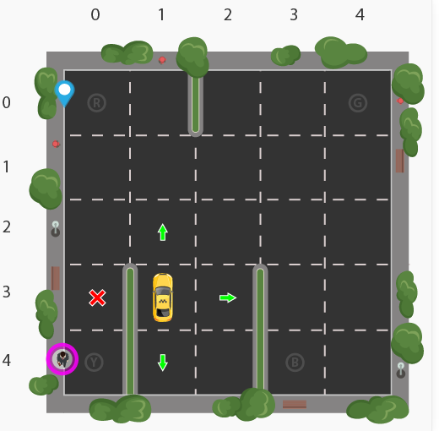
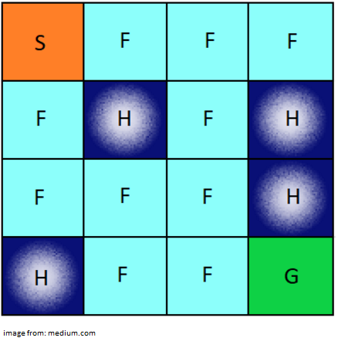
Projects

Slide 3
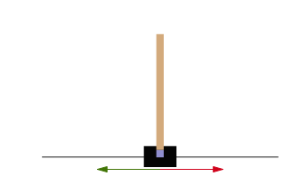
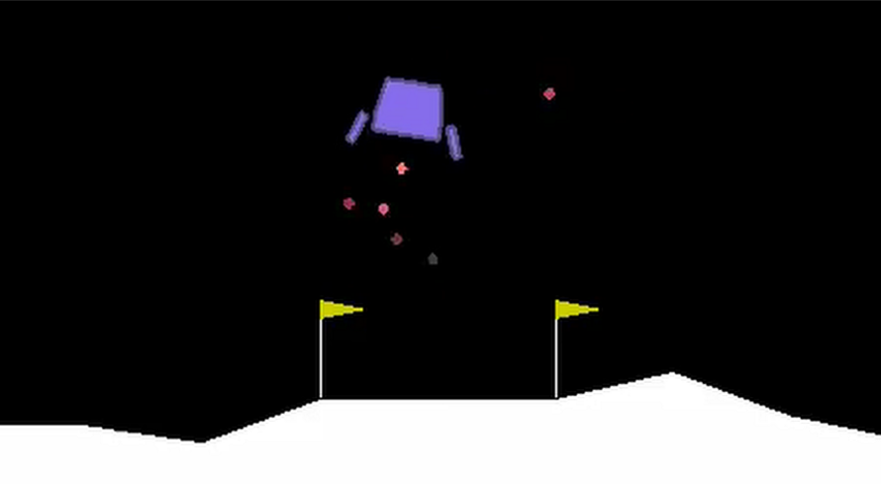
Projects

Slide 4
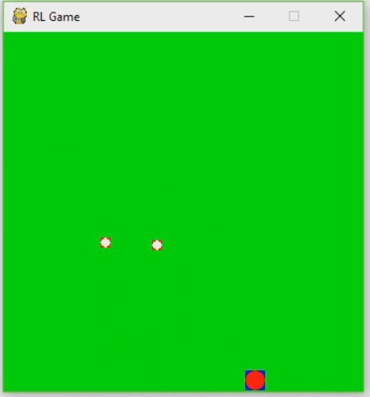
Projects

Slide 5

Projects

Slide 6

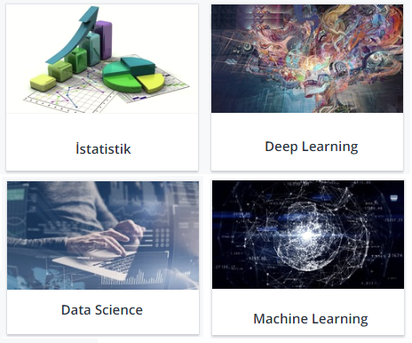

Slide 7
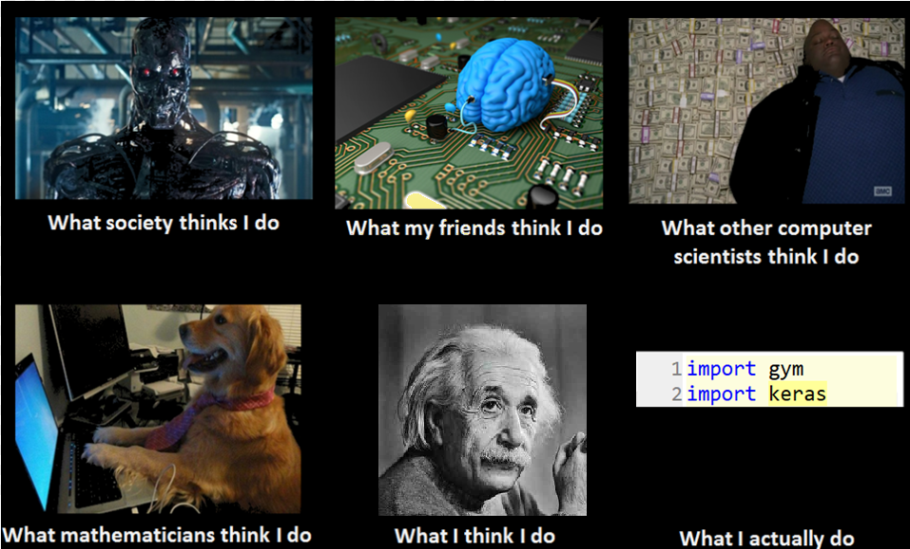

Slide 8
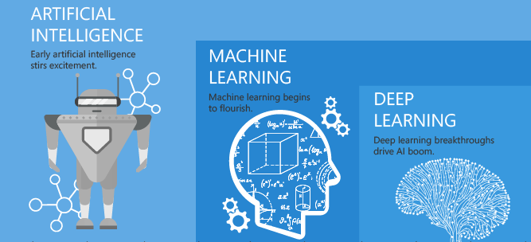
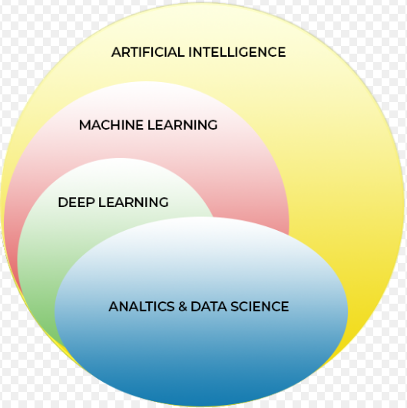

Slide 9
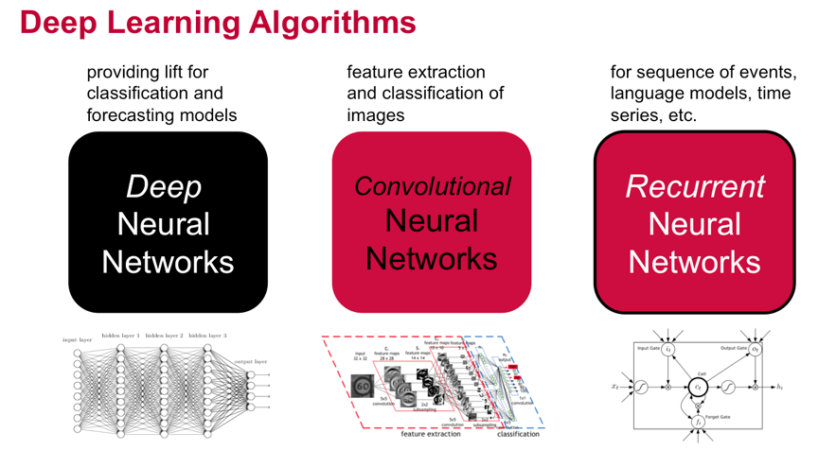

Slide 10
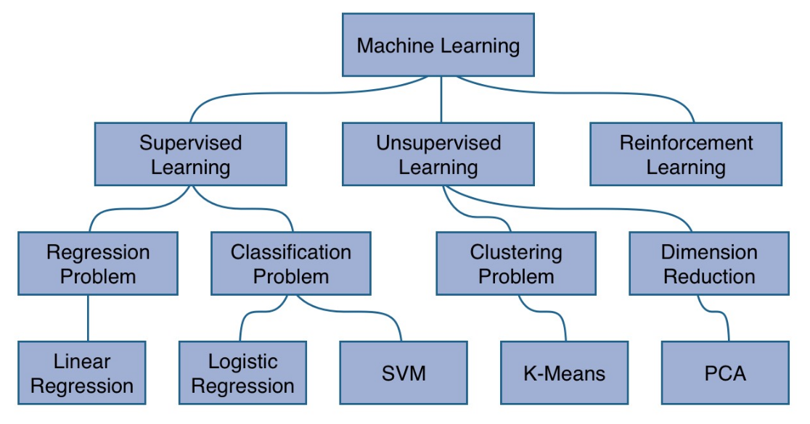

Slide 11
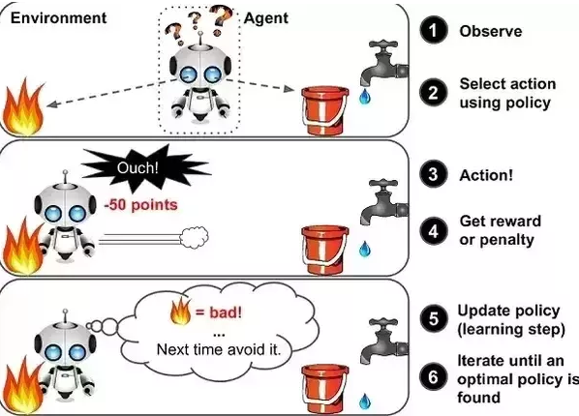

Slide 12
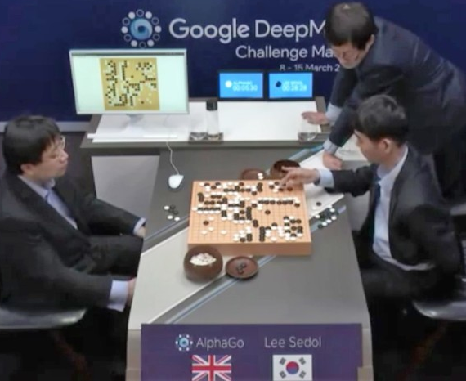
Alpha go

Slide 13
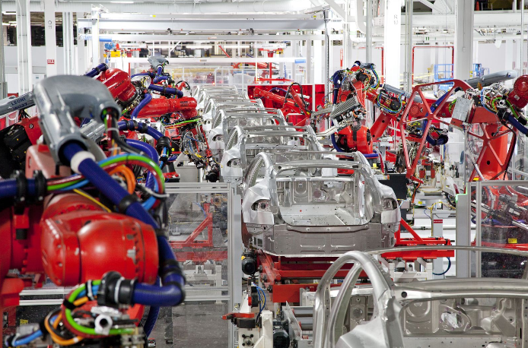
Manufacturing

Slide 14
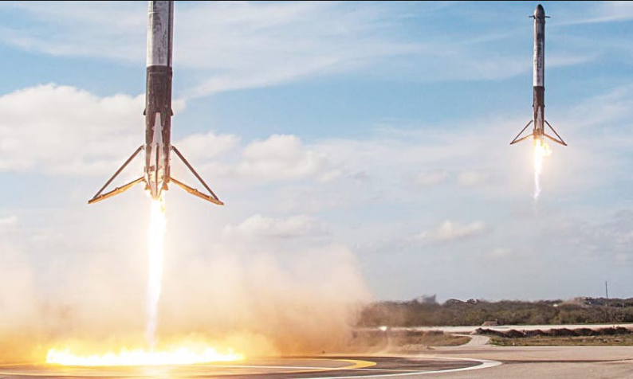
Landing a Rocket

Slide 15
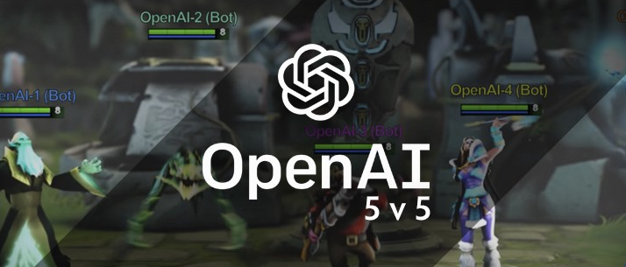
OpenAI-5

Slide 16
Anaconda & Python Packages
Anaconda
Gym
Keras
Pygame
Pybox2d

